Slide 1

Indiana Department of Administration On Behalf Of: Indiana’s Auditor of State (AOS), State Personnel Department (SPD) and the Indiana Office of Technology (IOT) Request for Proposal 19-105 Modernize the Human Resources and Payroll Business Processes and Technologies Pre-Proposal Conference June 25, 2019 10:00 AM Mark Hempel
Indiana Department of Administration

Slide 2
Agenda
General Information
RFP Information
Purpose and Term of RFP
Mandatory Requirements
Key Dates
Proposal Preparation & Evaluation
Minority and Women’s Business Enterprises (M/WBE)
Indiana Veteran Owned Small Business (IVOSB)
Question and Answer
Indiana Department of Administration

Slide 3
General Information
Sign-In Sheet for Attendees
Sign-In Sheet and PowerPoint will be posted on IDOA’s Solicitation Website
Hold questions until the end of the presentation
Any verbal response is not considered binding; respondents are encouraged to submit any question formally in writing if it affects the proposal that will be submitted to the state.
Indiana Department of Administration

Slide 4
Key Dates
Activity | Date
Issue of RFP | June 14, 2019
Deadline to Submit Round 1 of Written Questions | June 21, 2019 by 3:00 p.m. Eastern Time
Pre-Proposal Conference | June 25, 2019
Response to Round 1 of Written Questions/RFP Amendments | June 28, 2019
Deadline to Submit Round 2 of Written Questions | July 3, 2019 by 3:00 p.m. Eastern Time
Response to Round 2 of Written Questions/RFP Amendments | July 11, 2019
Intent to Respond & Vendor Qualification Response Templates | July 12, 2019 by 3:00 p.m. Eastern Time
Submission of Proposals | August 15, 2019 by 3:00 p.m. Eastern Time
The dates for the following activities are target dates only. These activities may be completed earlier or later than the date shown.
Proposal Evaluation & Shortlisting | August 15 – September 30, 2019
Proposal Discussions/Clarifications (if necessary) | August 20 – August 23, 2019
Oral Presentations & Demonstrations (if necessary) | October 21 – November 8, 2019
Best and Final Offers (if necessary) | November 18 – December 13, 2019
RFP Award Recommendation | December 2019
Indiana Department of Administration

Slide 5
Team Introductions
Glen Baker Program Leader
State Leaders
Brent Plunkett AOS Scarlette Harden GMIS
Sally Burnell SPD
Brandy Hooton GMIS Paula Hart AOS
Christy Tittle SPD Stan Kirk AOS
Kristy Hall SPD Shannon Bay AOS
Joanne Weber GMIS Margaret Blackburn AOS
Sean Cooper IDOA
Indiana Department of Administration

Slide 6
Purpose of the RFP
Select a qualified partner to provide PeopleSoft HCM 9.2 process and technology transformation and implementation services
Transforming HCM from the current 9.1 version to 9.2 eliminating all unnecessary customizations
Implementing PeopleSoft HCM payroll capabilities, replacing the GEAC legacy payroll solution, and integrating with other PeopleSoft functions
Transforming the HR and Payroll processes throughout State government to support the most efficient, effective implementation of the PeopleSoft HCM solution
Implementing tools and support processes to maintain future HCM product updates and facilitate continuous improvement
Potentially implementing additional value-added HCM-housed functional capabilities through new modules and capabilities such as Management of Accruals and Leaves, and Compensation
Indiana Department of Administration

Slide 7
Mandatory Respondent Qualifications
A qualified primary Vendor must have experience leading at least 2 large PeopleSoft 9.1 or 9.2 HCM upgrade/implementation projects to successful completion as the primary, contracted Vendor. The experience must include:
at least 1 PeopleSoft 9.1 or 9.2 HCM upgrade and/or implementation, within the past 7 years, for a U.S. state government with at least 25,000 employees who faced similar challenges as those explained in this RFP,
and
at least 1 additional PeopleSoft 9.1 or 9.2 HCM upgrade and/or implementation, within the past 7 years, for a legal entity (i.e. U.S. state government, U.S. local government, private company) with at least 25,000 employees who faced similar challenges as those explained in this RFP.
Indiana Department of Administration

Slide 8
Mandatory Respondent Qualifications
A qualified primary Vendor must have experience leading at least 2 large PeopleSoft 9.1 or 9.2 Payroll implementations to successful completion as the primary, contracted Vendor. The experience must include:
at least 1 PeopleSoft 9.1 or 9.2 HCM Payroll implementation, within the past 7 years, for a U.S. state government with at least 25,000 employees who migrated from a legacy system and faced similar challenges as those explained in this RFP,
and
at least 1 additional PeopleSoft 9.1 or 9.2 HCM Payroll implementation, within the past 7 years, for a legal entity (i.e. U.S. state government, U.S. local government, private company) with at least 25,000 employees who migrated from a legacy system and faced similar challenges as those explained in this RFP.
Indiana Department of Administration

Slide 9
Term of RFP
Contract Term
The term of the contract shall be for the implementation period and 6 months of post-implementation support as defined in the Cost Proposal.
Given the critical future support dates affecting both the PeopleSoft HCM 9.1 and GEAC Payroll systems, it should be concluded that an implementation period exceeding 30 months could be problematic.
Indiana Department of Administration

Slide 10
Business Proposal (Attachment E)
Company Financial Information (Section 2.3.3)
Confidential information must be kept separate from the proposal in both hard and soft copy
References (Section 2.3.6)
Respondent should include clients that closely match the scope and complexity of the services requested in the RFP
Contract Terms & Conditions (Section 2.3.5 of RFP and 2.3.15 of Business Proposal)
Respondent should review the Preliminary State contract and note exceptions to State mandatory and non-mandatory clauses within Section 2.3.15 of the Business Proposal
Indiana Department of Administration

Slide 11
Technical Proposal (Attachment F)
Please use the Templates and Workbooks we have provided for you.
Technical Requirements Workbook
Functional Requirements Workbook
Project Related Workbook
Approach Template
Project Plan Template
Staffing Plan Template
Statement of Work Template
Future-State Process Definition Template
Where appropriate, supporting documentation may be referenced by a page and paragraph number, and including the applicable ID number from the template.
Indiana Department of Administration

Slide 12
Cost Proposal (Attachment D)
The cost proposal is designed to capture significant cost detail by phase, month, project milestone and service provider where appropriate.
Cost Summary Detail
Implementation Services and Products
Implementation Maintenance Services and Products
Post-Implementation Maintenance Services and Products
Payment Schedule Detail
By month based on project plan milestones
Cost proposal detail must be aligned and consistent with appropriate detail in the business and technical proposals.
Indiana Department of Administration

Slide 13
Proposal Preparation
Buy Indiana, Business Proposal (2.3.14)
Status shall be finalized by proposal due date
5 definitions, details provided in Business Proposal
Email confirmation included in proposal from buyindianainvest@idoa.in.gov (See section 2.7)
This is required for any of the 5 criteria
Indiana Economic Impact, Attachment C
Definition of FTE (Full-Time Equivalent)
Example: If a Respondent has 5 full time employees and is bidding on its 5th contract, and all contracts get an equal amount of commitment from the employees then each employee commits 20% of his or her time to the new contract:
0.2 x 5 employees= 1 FTE.
Indiana Department of Administration

Slide 14
Proposal Preparation
Attachment D (Cost Proposal) must be returned in Excel
Use the templates and workbooks provided for all answers
Do not alter excel templates or workbooks except to add rows of detail where applicable
Submit all questions using templates and workbooks provided
Indiana Department of Administration

Slide 15
Proposal Evaluation
Summary of Evaluation Criteria:
Criteria | Points
Adherence to Mandatory Requirements | Pass/Fail
Management Assessment/Quality (Business and Technical Proposal) | 52 available points
Cost (Cost Proposal) | 23 available points
Indiana Economic Impact | 5 points
Buy Indiana | 5 points
Minority Business Enterprise Subcontractor Commitment | 5 ( 1 bonus point is available, see Section 3.2.6)
Women Business Enterprise Subcontractor Commitment | 5 ( 1 bonus point is available, see Section 3.2.6)
Indiana Veteran Owned Small Business Subcontractor Commitment | 5 (1 bonus point is available, see Section 3.2.7)
Total | 100 (103 if bonus awarded)
Indiana Department of Administration

Slide 16
Minority and Women’s Business Enterprises
Mission/Vision
Promote, monitor, and enforce the standards for certification of minority and women’s business enterprises.
Provide equal opportunity to minority and women enterprises in the state’s procurement and contracting process.
Nondiscrimination and Antidiscrimination Laws
Pursuant to Indiana Civil Rights Law, specifically IC §22-9-1-10, every state contract shall contain a provision requiring the contractor and subcontractors to not discriminate against any employee or applicant with respect to Protected Characteristics
Indiana Department of Administration

Slide 17
Minority and Women’s Business Enterprises
Contact Information
Phone: 317-232-3061
E-mail: mwbecompliance@idoa.in.gov
Web: www.in.gov/idoa/mwbe
Complete Attachment A, MWBE Form
- Include sub-contractor letter of commitment
Goals for Proposal
- 8% Minority Business Enterprise
- 8% Women’s Business Enterprise
Indiana Department of Administration

Slide 18

Indiana Department of Administration

Slide 19
Minority and Women’s Business Enterprises
Prime contractors must ensure that the proposed subcontractors meet the following criteria:
Are listed in the IDOA Directory of Certified Firms, on or before the proposal due date, national diversity plans are generally not accepted. The directory can be found here: http://www.in.gov/idoa/mwbe/2743.htm
Serve a Valuable Scope Contribution (VSC) on the engagement, as confirmed by the State.
Provide the goods or services specific to the contract and within the industry area for which it is certified
Indiana Department of Administration

Slide 20
Minority and Women’s Business Enterprises
Prime contractors should note the following:
Subcontractors’ MBE/WBE Certification Letter, provided by IDOA, must accompany the proposal to show current status of certification.
Each firm may only serve as one classification – MBE, WBE, or IVOSB (see section 1.22)
Pursuant to 25 IAC 5-6-2(b)(d), a Prime Contractor who is a MBE or WBE must meet subcontractor goals by using other listed certified firms. Certified Prime Contractors cannot count their own workforce or companies to meet this requirement.
Indiana Department of Administration

Slide 21
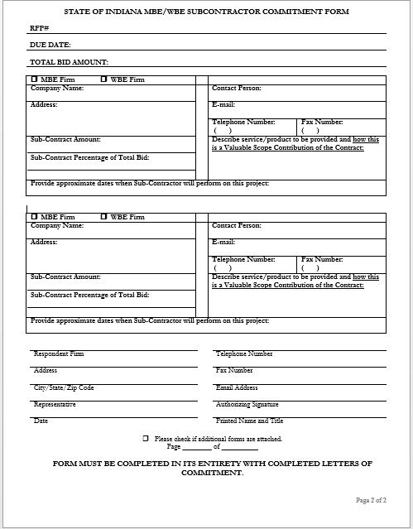
19-105
August 15, 2019
Indiana Department of Administration

Slide 22
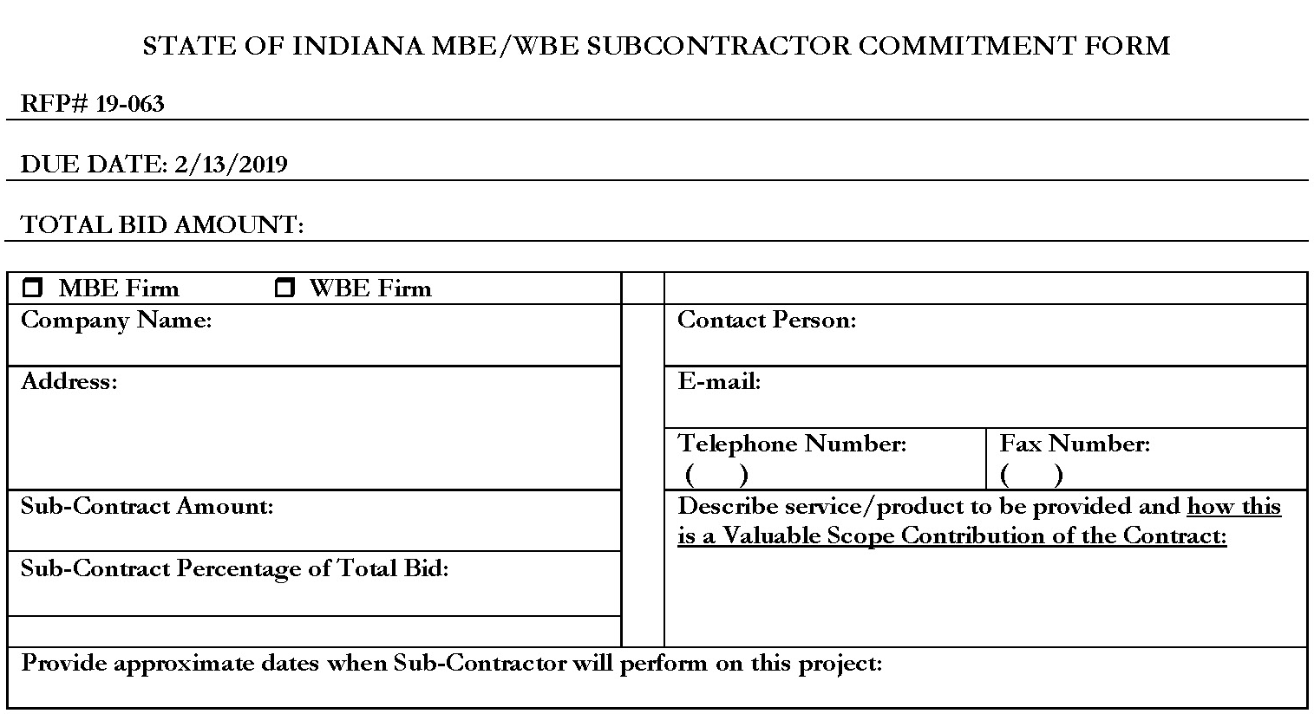
Minority and Women’s Business Enterprises
19-105
August 15, 2019
Indiana Department of Administration

Slide 23
Minority and Women’s Business Enterprises
New Process – Effective 2014, MWBE scoring is conducted based on 10 points plus a possible 2 bonus points scale
MBE: Possible 5 points + 1 bonus point
WBE: Possible 5 points + 1 bonus point
Professional Services Scoring Methodology:
The points will be awarded on the following schedule:
Fractional percentages will be rounded up or down to the nearest whole percentage
If the respondent’s commitment percentage is rounded down to 0% for MBE or WBE participation the respondent will receive 0 points.
Submissions of 0% participation will result in a deduction of 1 point in each category
The highest submission which exceeds the goal in each category will receive 6 points (5 points plus 1 bonus point). In case of a tie both firms will receive 6 points
% | 1% | 2% | 3% | 4% | 5% | 6% | 7% | 8%
Pts. | .625 | 1.25 | 1.875 | 2.5 | 3.125 | 3.75 | 4.375 | 5.0
Indiana Department of Administration

Slide 24
Indiana Veteran Owned Small Business
Contact Information
Phone: 317-232-3061
E-mail: Indianaveteranspreference@idoa.in.gov
Web: www.in.gov/idoa/2862.htm
Complete Attachment A1, IVOSB Form
Include sub-contractor letters of commitment
Goals for Proposal
3% Indiana Veteran Owned Small Business
Indiana Department of Administration

Slide 25
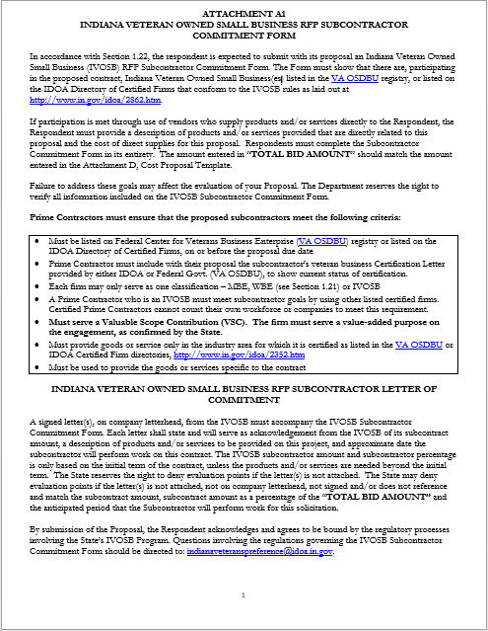

Slide 26
Indiana Veteran Owned Small Business
Prime contractors should note the following:
Pursuant to 25 IAC 9-4-1(c), a Prime Contractor who is an IVOSB can use their own workforce to count toward the goal.
IVOSB must have a Bidder ID (see section 2.3.7 - Department of Administration, Procurement Division).
Prime contractor and/or subcontractors’ Certification Letter(s), provided by IDOA or VA OSDBU, must accompany the proposal to show current status of certification.
Each firm may only serve as one classification – MBE, WBE (see section 1.21), or IVOSB.
Indiana Department of Administration

Slide 27
Indiana Veteran Owned Small Business
Prime contractors must ensure that the proposed subcontractors meet the following criteria:
Must be listed on Federal Center for Veterans Business Enterprise (VA OSDBU) registry or listed on the IDOA Directory of Certified Firms, on or before the proposal due date.
Serve a Valuable Scope Contribution (VSC) on the engagement, as confirmed by the State.
Provide the goods or services specific to the contract and within the industry area for which it is certified
Indiana Department of Administration

Slide 28
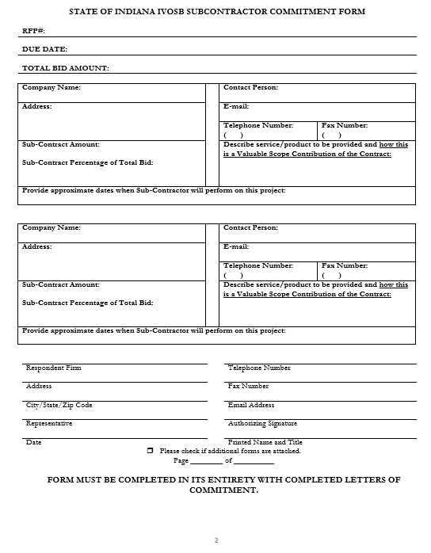
19-105
August 15, 2019
Indiana Department of Administration

Slide 29
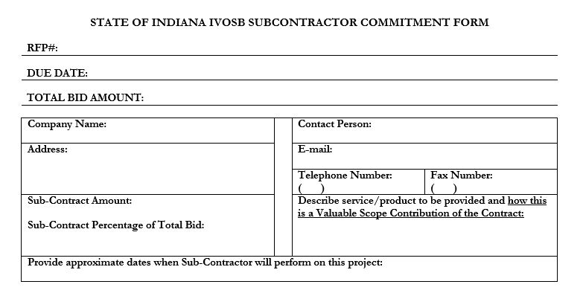
Indiana Veteran Owned Small Business
19-105
August 15, 2019
Indiana Department of Administration

Slide 30
Indiana Veteran Owned Small Business
New Process - IVOSB scoring is conducted based on 5 points plus a possible 1 bonus point scale
- IVOSB: Possible 5 points + 1 bonus point
Professional Services Scoring Methodology:
The points will be awarded on the following schedule:
Fractional points will be awarded based upon a graduated scale between whole points. (e.g. a 0.3% commitment will receive .5 points and a 1.5% commitment will receive 2.5 points)
Submissions of 0% participation will result in a deduction of 1 point in each category
The highest submission which exceeds the goal in each category will receive 5 points (5 points plus 1 bonus point). In case of a tie both firms will receive 6 points.
% | 0% | 0.6% | 1.2% | 1.8% | 2.4% | 3%
Pts. | -1 | 1 | 2 | 3 | 4 | 5
Indiana Department of Administration

Slide 31
IDOA Subcontractor Scoring
RFP MBE/WBE/IVOSB Scoring Example
Bidder | MBE % | Pts. | WBE % | Pts. | IVOSB % | Pts. | Total Pts.
Bidder 1 | 12.0% | 5.0 | 10.0% | 6.0 | 3.5% | 6.0 | 17.00
Bidder 2 | 6.0% | 3.75 | 4.0% | 2.5 | 1.8% | 3.0 | 9.25
Bidder 3 | 8.0% | 5.0 | 8.0% | 5.0 | 3.0% | 5.0 | 15.00
Bidder 4 | 16.0% | 6.0 | 0.2% | 0.0 | 0.6% | 1.0 | 7.00
Bidder 5 | 0.0% | -1.0 | 0.0% | -1.0 | 0.0% | -1.0 | -3.00
Indiana Department of Administration

Slide 32



Subcontractor Compliance
Pay Audit System
Tool utilized to monitor the state’s diversity spend for subcontractors
Selected primes and subcontractors are required to report payments submitted or received through this web-based tool
Based on contract terms payments should be reported monthly or quarterly
Questions? Contact Division of Supplier Diversity
mwbecompliance@idoa.in.gov
www.in.gov/idoa/mwbe/payaudit.htm
Prime
Submit subcontractor actual paid invoice amounts
Payment
Pay Audit System
Submit actual payments received
Subcontractor
Indiana Department of Administration

Slide 33
Additional Information
IDOA PROCUREMENT LINKS AND NUMBERS
http://www.in.gov/idoa/2354.htm
A. For Vendor Registration Questions:
http://www.in.gov/idoa/2464.htm
B. Secretary of State of Indiana:
Can be reached at (317) 232-6576 for registration assistance. www.in.gov/sos
C. See Vendor and Supplier Resource Center:
http://www.in.gov/idoa/3106.htm
Minority and Women Owned Business Enterprises:
Link to more information and full listing of IDOA Minority and Women Owned Businesses
http://www.in.gov/idoa/2352.htm
Indiana Veteran Owned Small Business Program:
Link to more information and full listing of Indiana Veteran Owned Small Businesses: http://www.in.gov/idoa/2862.htm. To search certified IVOSBs: https://www.vip.vetbiz.va.gov
F. RFP posting and updates:
Go to http://www.in.gov/idoa/2354.htm (select “Current Opportunities” link)
Scroll through table until you find desired RFP number on left-hand side and click the link.
Indiana Department of Administration

Slide 34
Questions
Any verbal response is not considered binding; respondents are encouraged to submit any question formally in writing if it affects the proposal that will be submitted to the state.
Indiana Department of Administration

